Slide 1
HOW ARE WE DOING?
Opening talk at SCANPUB’s 2nd Winter Symposium
Helsinki Collegium for Avanced Studies
25 January 2018

Slide 2
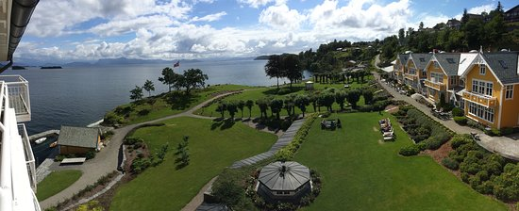
1st Summer Symposium: Solstrand Fjord Hotel, August 2016

Slide 3
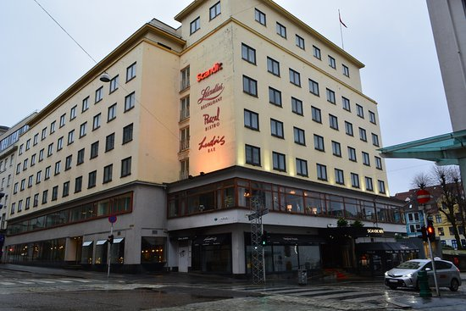
1st Winter Symposium: Hotel Neptun, Bergen

Slide 4
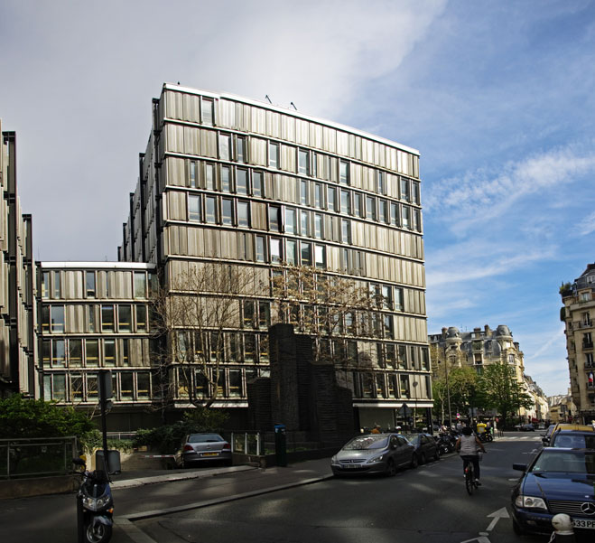
2nd Summer Symposium: Maison des Sciences de l’Homme (MSH) - Paris

Slide 5
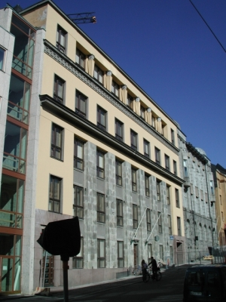
2nd Winter Symposium: Helsinki Collegium for Advanced Studies

Slide 6
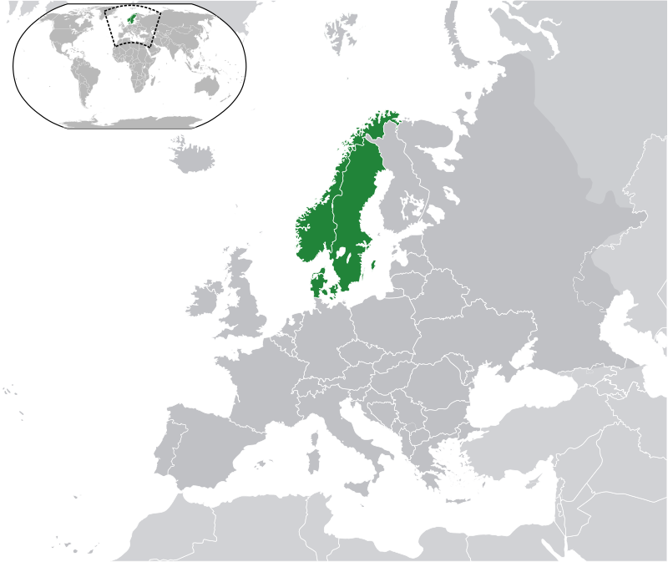
What SCANPUB is supposed to do
Study concretely and write the history of immigration debates in the 3 Scandinavian countries
Improve our knowledge of what migration is and entails
Contribute to our knowledge of how liberal democracies function and especially the role of the public sphere

Slide 7
More specifically also –
Improve our understanding of
(a) the current role and nature of the nation-state,
(b) the role of the cultural public sphere,
c) the role of public discourse in relation to political decision-making

Slide 8
5 ”work packages” –
WP1 - the comprehensive quantitative content analysis of key newspapers and TV channels in peak years for public debate on the issue and also qualitative analyses of a strategic sample of a variety of texts including fiction;
WP 2 is to do a systematic evaluation of mediated public discourse based in normative theories of public deliberation;
WP3 is to investigate relations between mediated public discourse an attitudes and understandings among the public through subprojects, one of which deals with online media;
WP4 is to study relations between mediated public discourse and political decision-making, while
WP5 will assess explanatory factors and implications for public sphere theory

Slide 9
So where are we now, after 1,5 years?

Slide 10
WP 1: Quantitative & qualitative content analysis
(a) We are practically done with the collection-of-data part of the quantitative content analysis of key newspapers. It was A LOT more expensive and difficult than anticipated. A first paper has been presented at ECREA event in Zürich.
(b)We have completed a comparative project based on quantitative methodology in cooperation with the LSE on the ”refugee crisis” in 2015. A paper was presented at an ECREA event in Bilbao and is about to be published.
(c) A gigantic collection of newspaper ”clippings” is waiting for analyses
(d) Our systematic analysis of tv channels has only just about begun.
(e) We have not really identified particular ”peak years” of debate – our time-line of events/developments is far from finished.
(f) A few qualitative analyses of film/television/theatre/literature about or related to migration have been prepared. We have compiled lists of relevant films/programs for each country, but these have not been analysed/used.

Slide 11
WP2: Systematic evaluation of public discourse in light of deliberative ideals
We have some rhetorical analyses of e.g. TV debates but nothing that approaches a systematic comparison between public discourse more generally in Denmark, Norway and Sweden
A major question we should discuss, is actually how such an evaluation can be done systematically and not just end up with a set og random examples
How about a study of meta-debates: Debates about the immigration debate and its (lacking) standard?

Slide 12
WP3: Mediated public discourse and the public’s opinions and attitudes; including online media
No systematic gathering of relevant attitude/opinion polls 1970-2016 in Scandinavia (and Europe) has so far been attempted.
1 professor and 2 PhD students are working on online media; this is a (the?)high emphasis part of SCANPUB. They should also look into the question of media impact (including social media).
This WP also depends on our time series and the representative content analysis

Slide 13
WP 4: Mediated public discourse and political decision-making
Only 1 researcher in a 2 year position is directly working on this
Even if she is very good, we need also other people to pay attention to this issue: It is very central to SCANPUB’s overarching issues
How do we organize this?
How about distinguishing between different public spheres or parts of the general, national public sphere: Scholarly contributions, scholars’ ”dissemination”, commissioned expert work – versus other areas of public discourse?

Slide 14
WP5: Explanatory factors and implications for public sphere theory
The notion of ”explanation” has been discussed in internal seminars but no concrete systematic list of explanatory factors has been proposed since the project proposal was written.
Various theoretical and historical work such as that on citizenship conducted collectively in Les Arcs in September 2017 and that of yours truly on ”the nation”, ”nationalism” etc belongs here. None of it is as of now properly published
How do we organize this work from now on? Who contributes?

Slide 15
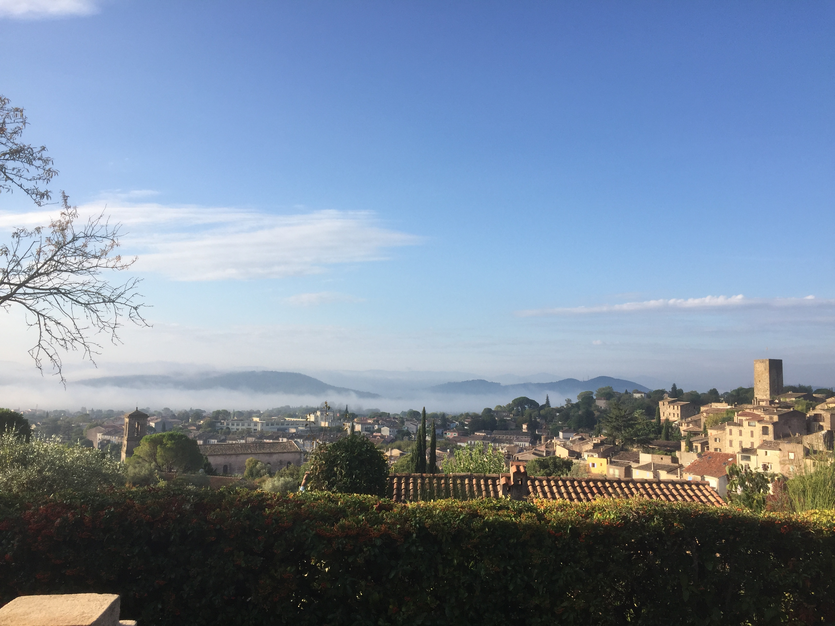
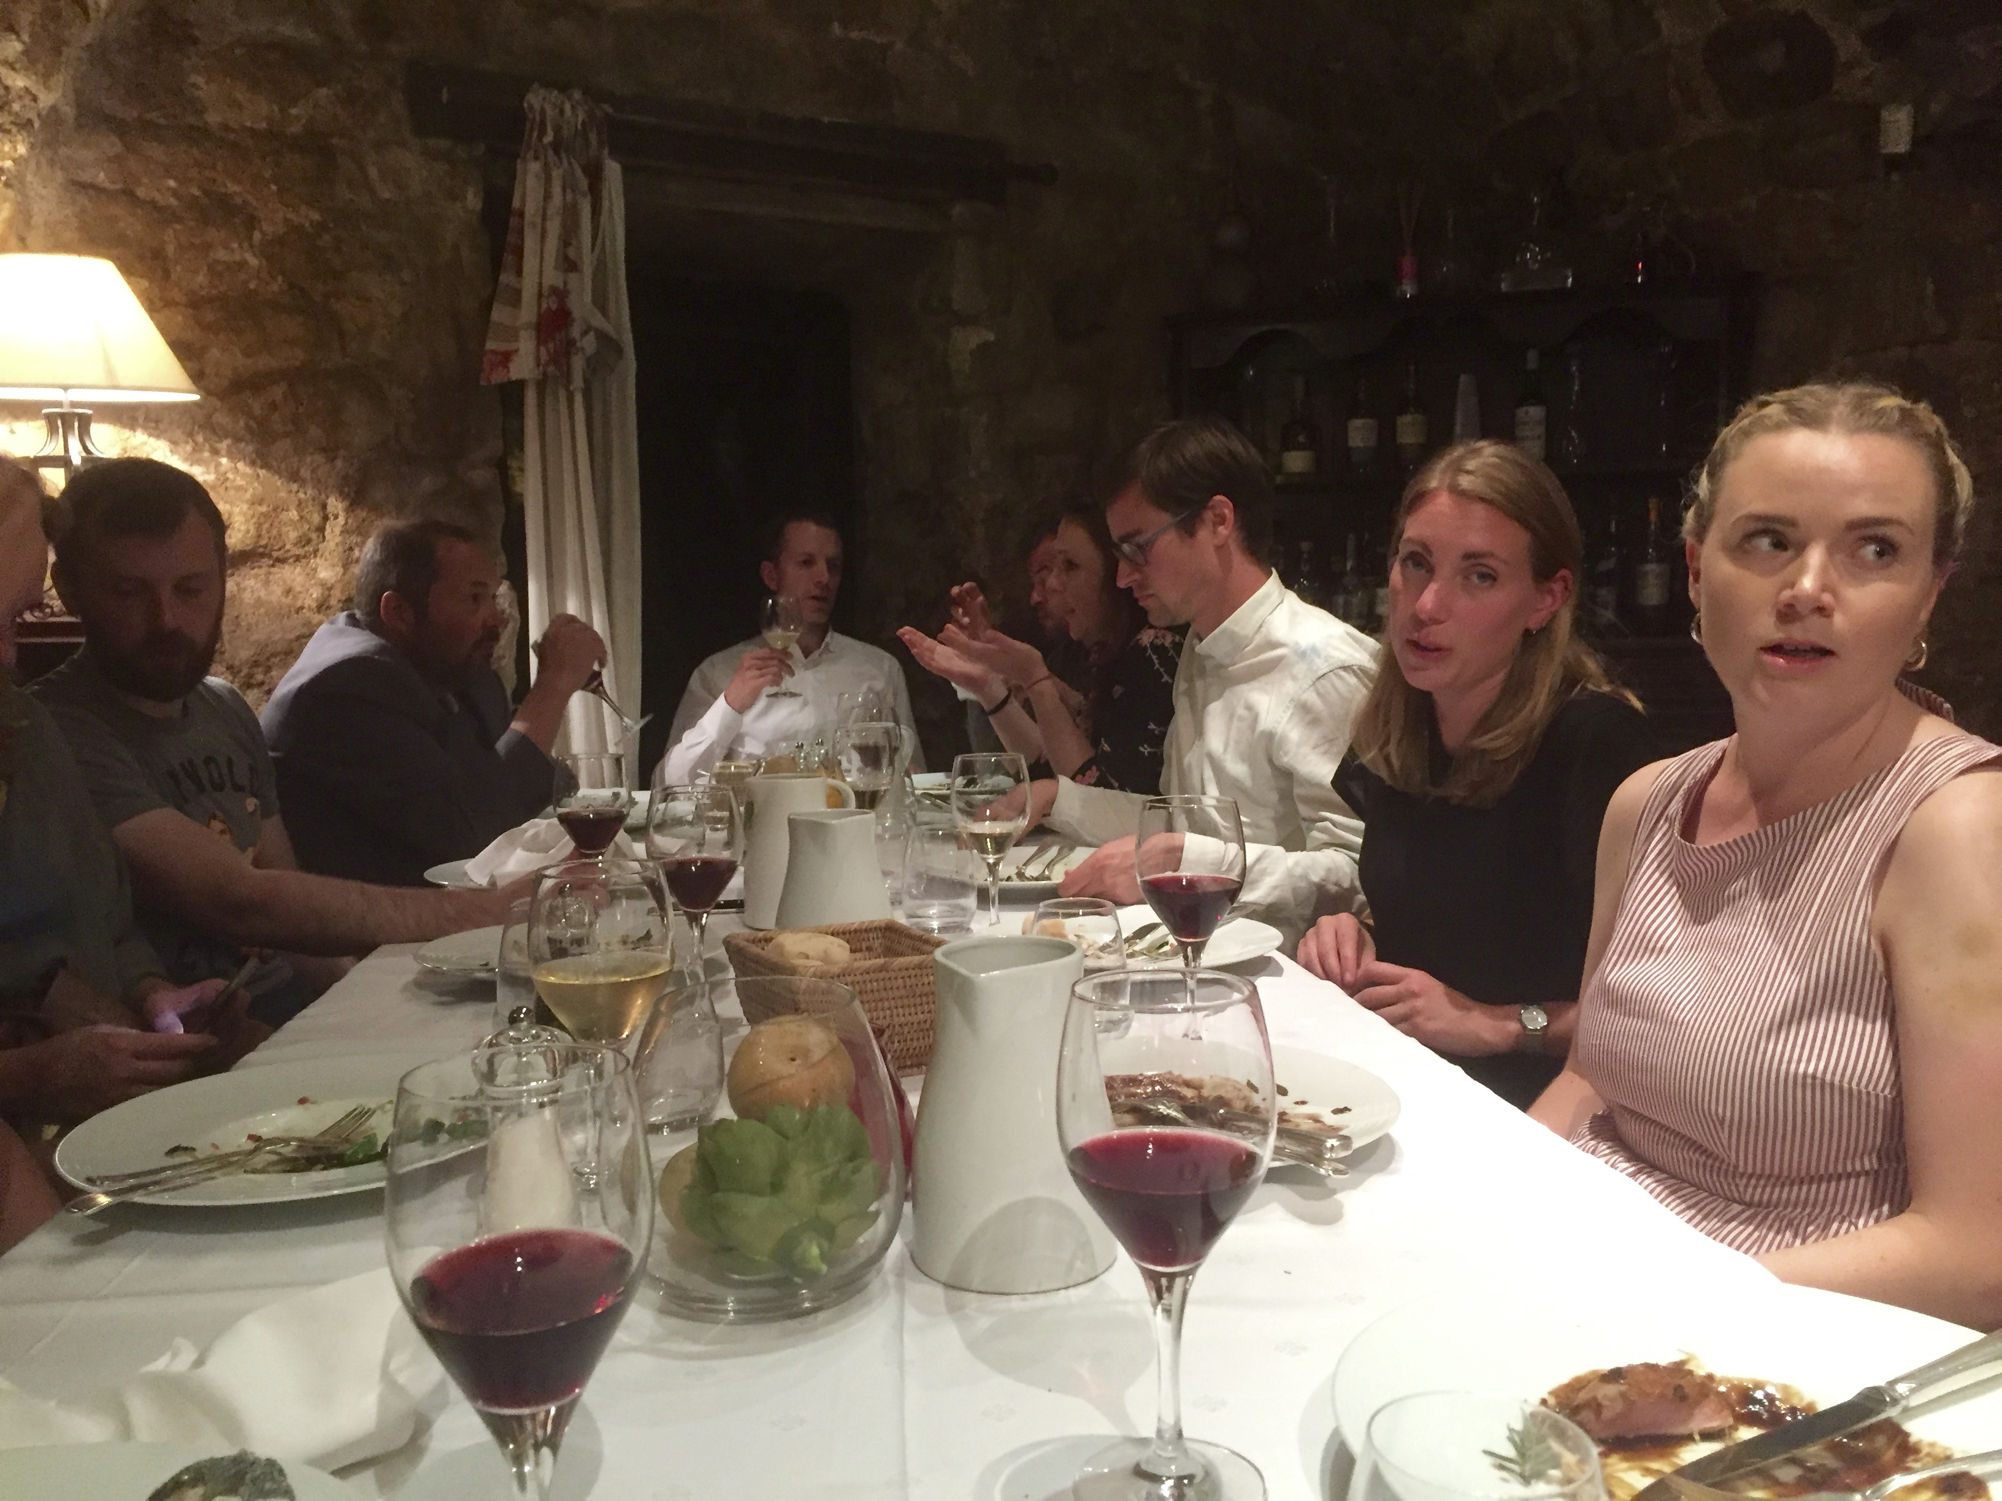
Intensive 2-day seminar on democratic theory, Les Arcs-sur-Argens, September 2017

Slide 16
Future ways of working
Perhaps one or two events per semester, more or less like the one in Les Arcs, might provide better opportunity for congenial and innovatory work on issues we are collectively responsible for?

